Slide 1
Promoting healthy Hearing in musicians
Christine D. Njuki, Au.D., CCC-A
Clinical Professor
Audiologist

Slide 2
Overview
The Ear
Music Induced hearing loss-why we don't want it
Are you at risk?
Healthy hearing behaviors
Hearing protection for musicians
Additional resources

Slide 3
How the ear works

Slide 4
How the ear works
The inner ear (cochlea) is tonotopically organized
http://bcove.me/gtvm0psh

Slide 5
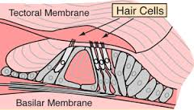
How the ear works
Hyperphysics.phy-astr.gsu.edu
16000 hair cells sitting on the basilar membrane
Shearing occurs with basilar membrane movement

Slide 6
How the ear works

Slide 7
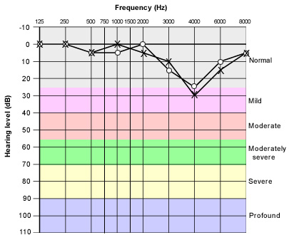
Characteristics of music -induced hearing loss (MIHL)
Gradual decline in hearing
Early stages are rarely detected
It doesn’t have to hurt!
Loss of fidelity, specifically higher pitches, not volume
http://www.aafp.org/afp/2000/0501/p2749.html

Slide 8
High frequency Hearing loss simulation
http://www.hearinglikeme.com/facts/what-hearing-loss/hearing-loss-simulator-understanding-mild-and-moderate-hearing-loss

Slide 9
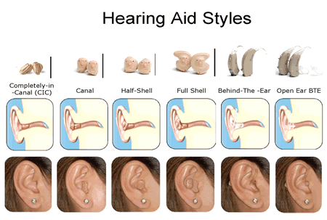
Treatment options are poor
We cannot generate new hair cells……yet
Hearing aids are designed for communication, not music appreciation

Slide 11
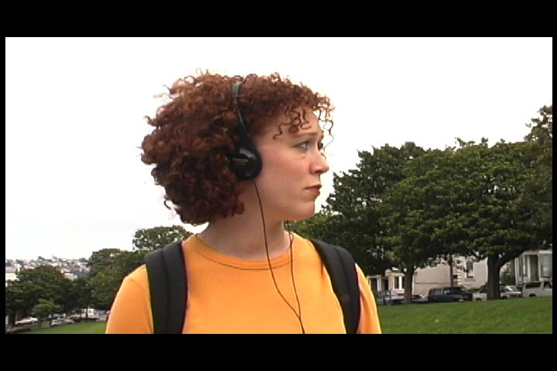
Other symptoms of MIHL
https://www.youtube.com/watch?v=Dgq-ka1FkZk
http://hearnet.com/features/feature_PSA.shtml
http://hearnet.com/audio_video/video/mermen.mov
http://www.hearnet.com/audio_video/video/Hearnet_Protect.mov
Other symptoms may be worse than the hearing loss
Permanent and constant tinnitus
Poor pitch perception
Hypersensitivity to loud sound

Slide 12
Are you at risk?

Slide 13
National Institute of Occupational Safety & Health

Slide 14
Intensity
How loud is too loud?
85dBA SPL (dial tone)

Slide 15
Intensity
MAXIMUM LEVELS FOR INSTRUMENTS (WAGNER RING CYCLE: CAMP AND HORSTMAN, 1992)
Instrument | Peak Level (dB SPL)
French Horn | 107
Bassoon | 102
Trombone | 108
Tuba | 110
Trumpet | 111
Violin | 109
Clarinet | 108
Percussion | >120
(Amplified Guitar | >115)

Slide 16
duration
How long is too long?
40 hours per week
Classically trained musicians tend towards higher noise exposure than rock musicians because of the amount of time exposed.

Slide 17
NOise dosage = duration and Intensity
85dBA SPL over a 40-hour work week = safe
3dB Exchange Rate (+3dB = sound exposure doubles and safe listening time is cut in half)
UT Dallas has explored positive effects of ensemble instructors consciously setting practice agendas with overall noise dose in mind
> 100% noise dose is associated with hearing damage

Slide 18
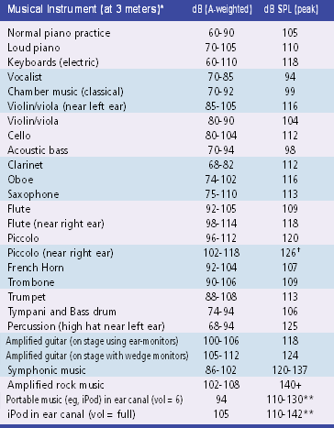
Chasin (2006)
Safe listening time
85 = 8 hours
88 = 4 hours
91 = 2 hours
94 = 1 hour
100 = ½ hour

Slide 19
Track your own noise dose
NIOSH Sound level meter App
https://www.cdc.gov/niosh/topics/noise/app.html

Slide 20
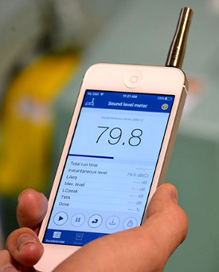
Track your own noise dose
NIOSH Sound level meter App
https://www.cdc.gov/niosh/topics/noise/app.html

Slide 21
UConN Musiconn study - in press
Noise Dose of 56 UCONN students
(not including ear/headphone use!)
Non-Musicians Musicians
Mean = 41% 293%
Range = 1-294% 7 – 902%

Slide 22
What about the musical brain?
The Musician Advantage?
Years of playing = speech in noise ability

Slide 23
What about noise exposure on the musical Brain?
Routine noise exposure = speech in noise ability
Standard hearing test = normal results

Slide 24
Warning signs of Outer Hair cell damage
Tinnitus (noises in your ears)
Ringing
Buzzing
Hissing, etc.
“Temporary” decrease
Muffled,
muted,
ears may “feel” plugged
Temporary can become permanent

Slide 25
Healthy Hearing behaviors reducing intensity and duration
Use noise cancelling headphones in noisy areas (bus, mowing, gym, plane) when it is safe to do so
Reduce the volume and/or duration of personal music devices
80-90 rule for MP3 players (80% volume for 90 minutes) = 50% dose , Fligor 2006 (50% volume is safe for any length of time)
Turn up your favorite song, then turn it back down.
Give your ears at least 14 hours of “recovery time”, but realize that it is a warning sign and may become permanent
Humming can be used as a temporary protective mechanism
Take quiet breaks whenever possible

Slide 26
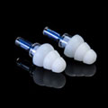
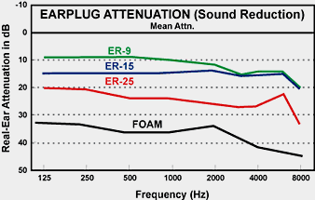
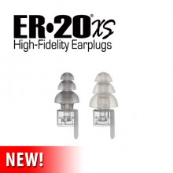
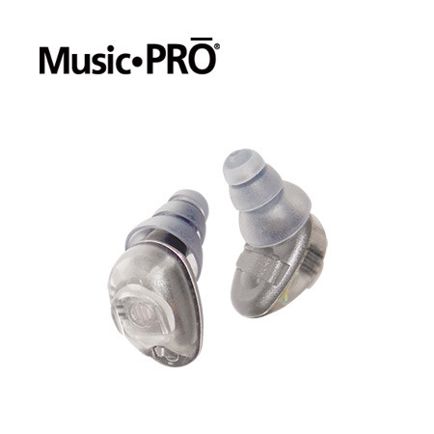
Hearing Protection
Sound quality???
Custom and non-custom
High fidelity
Designed for musicians
Can you use too much?

Slide 27
Additional resources
UCONN Speech & Hearing Clinic (860)486-2629
https://music.uconn.edu/health-and-wellness/
Musicians’ Clinics of Canada: http://www.musiciansclinics.com/
Which earplug is right for you?
https://www.etymotic.com/consumer/hearing-protection/which-earplug
Hearing Education and Awareness for Rockers:
www.hearnet.com
National Association of Schools of Music
http://nasm.arts-accredit.org/
Performing Arts Medicine Association
http://www.artsmed.org/

Slide 28
references
"Noise Exposure May Diminish the Musician Advantage for Perceiving Speech in Noise", Skoe, Camera, Tufts - in press
"Examining the noise life of the Musician: a weelong noise dosimetry of music and non-music activities, Tufts and Skoe IJA 2017; early online: 1-8
“Output levels of MP3 players” Portnuff and Fligor, NIHL in Children at Work and Play Conference, October 2006
Marshall Chasin powerpoint lecture slides (#15,17): www.musiciansclinics.com

