Slide 1
Scoring the Gig
Career Skills for the Discerning UConn Musician
Ian Maxwell
Sheila Kennedy
Michael Patterson
Tommy Gracy

Slide 2
What’s the big deal?
Musicians face unique challenges
Low/inconsistent income
Extreme Competition
Benefits? Maybe? Sometimes?
Musical Entrepreneurship
Self Promotion
Networking
Managing multiple incomes
Our Independent Study Process
We Interviewed professors. What was their professional experience?
Research Career Skills
Answer the Question:
How can we be ready to score the gig once we get out of school?

Slide 3
Self-Promotion
“You’re going to hear ‘no thank you’ a lot more than you’re going to hear ‘okay, sign here, here’s your lucrative orchestral contract.’”

Slide 4
Self Promotion
Marketing yourself = pounding pavement
“Cold Calling” → 10 calls, 1 lead
What are the tools you use to demonstrate your skills and musical background?

Slide 5
Tools of the Trade
The Résumé
Piques the reader’s interest → gets you in for interview or audition
Start by making a list; what musical work have you done?
Eastman Resume Writing Guide
UConn Resume Guidebook
Contact information
Education and Training
Degree, GPA
Major/Principal teachers
Summer Festivals
Performance Experience
Ensembles
Operatic Roles
Repertoire
Compositions/Arrangements
Recordings
Competitions
Honors/Awards

Slide 6
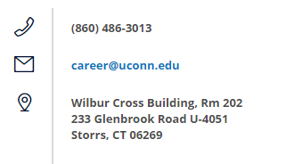
Career Development
UConn Center for Career Development
https://career.uconn.edu/
Résumé Help
Career Consulting
Practice Interviews
Internships search
Peabody Music and Entrepreneurship Career Center

Slide 7
The Website
“It’s got the things that concert promoters are always asking for: bios, photos, the press kit, contact information.”
“It has to be clean, informative, and to the point.”

Slide 8
The Website
As if your Resume wasn’t enough! (It isn’t…)
Essential marketing tool → shows big picture
Quick way for prospective employers to gauge you
Shows professionalism
Clean website = instant legitimacy

Slide 9
The Website: Your Resume, on Crack-Cocaine
Your Website Should Have…
The Checklist
Get professional headshots done
Get recordings → UConn records all concerts…did you have a solo?
Get good quality video of your recitals
Make your own! Start a SoundCloud
Write a bio/have one written
How to Write a Killer Artist Bio
Your bio
Headshots/pictures from performances
Videos of performances
Audio recordings
Your résumé/CV
Contact information
Reviews/news (maybe even a blog!)

Slide 10
Websites: Places to Start
Some Helpful Links:
Expert Tips for the Best Musician and Band Websites
Your Multimedia Resume: The EPK (Electronic Press Kit)
Get your Website Seen: Search Engine Optimization
Social Media → The Art of the Fire Facebook Events
Advice on Writing your Bio
Free Websites
Easy to update yourself
Don’t have to wait for somebody to do it for you
Fairly flexible
….free
www.weebly.com
www.wix.com
www.wordpress.com
Paid Example
https://bandzoogle.com/features
https://www.joomla.org/

Slide 11
Networking: Schmoozing for Gigs
“It’s not what you know, it’s who you know”
“Identify people who are doing what it is you aspire to do, and find out how they got to where they are. Get to know them.”

Slide 12
Professional Associations
Join a professional association
Excellent for networking: colleagues, mentors, prospective employers
Learn about upcoming opportunities
Stay current in your field
Student discount memberships
Connecticut Music Educators Association (CMEA)
American Choral Directors Association (ACDA)
College Music Society
Chorus America
Chamber Music America
Society of Composers
International Society for the Performing Arts FB Page

Slide 13
Summer Festivals
Laurel, Bowdoin, Tanglewood, etc.
Top-notch networking
Donors, future colleagues from all different schools
Today’s orchestra buddy, tomorrow’s Josh Bell?
Premier new music
Expensive? Yes. Worth it? Totally.
Scholarships and fellowships are almost always available
Check outside the music office for information
Directory of Summer Festivals

Slide 14
Colleagues can endorse you for skills
Find new opportunities and hidden jobs
Reach out to potential mentors!
Bother Ian on LinkedIn
Professional Social Network
Opportunity to showcase:
Education
Professional experiences
Accomplishments
Special projects
Multimedia Samples

Slide 15
Supplementary Income: “The Side Gig”
Musicians need multiple income sources
You might have a steady gig, but early on, it may not pay the bills
You need a day job with flexibility!
Keeps nights and weekends open for gigs/rehearsals
Leverages transferable skills

Slide 16
What are transferable skills?
Also known as “soft skills”
As a musician, you develop many of them!
Skills that can be applied to wide range of jobs regardless of direct experience
Talk about skills developed in rehearsal
Great for when you are applying for jobs in or outside of music
Shows what skills you bring to the table when talking to prospective employers
Gained in Rehearsal
Interpersonal communication
Organizational skills
Problem solving
Teamwork
Detail orientation
Time management
Leadership

Slide 17
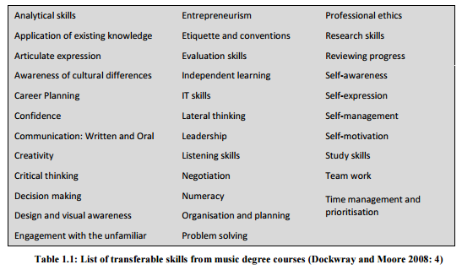
More Transferable Skills
Bassett, P. (2013) Benefits beyond Music: Transferable Skills for Adult Life (Unpublished master’s thesis). University of Sheffield, Sheffield, England

Slide 18
“Contracting” Work
Some Day Job Ideas
Private music studio (lessons)
Fitness instructor/personal trainer
Restaurant work
Pet care services
Private tutor
Piano tuner/technician
Social media manager
Car service/taxi
Event catering
Uber Driver
Lyft Driver
Uber Eats
Amazon Flex
Side Jobs For Working Musicians
Careers In Music — Day Job Search

Slide 19
Gig Resources
Auditions Plus - Directory for Audition Postings
Peabody Job Search Resources
International Musician - Orchestral Opportunity Database
Choral Net - Classifieds for Choral Opportunities
Indeed.com - Church Music Jobs
Search Engine for Music Competitions
American Composers Forum

Slide 20
Find Guidance
“The more important thing is that I consult with people who have expertise in areas where I aspire to excel.”
Find mentorship!
Teachers, Professors, Professionals
Never be afraid to ask
Talk to people who do what you want to do
Ask them out for coffee, lunch, interview them
We did interviews, too — see what we found out!

